Slide 1
HOSPITAL MANAGEMENT SYSTEM
Lola Ardura, Alejandra García, Inés Martín y Ainhoa Rey

Slide 2
E-R DIAGRAM
TABLES
USER INTERFACE

Slide 3
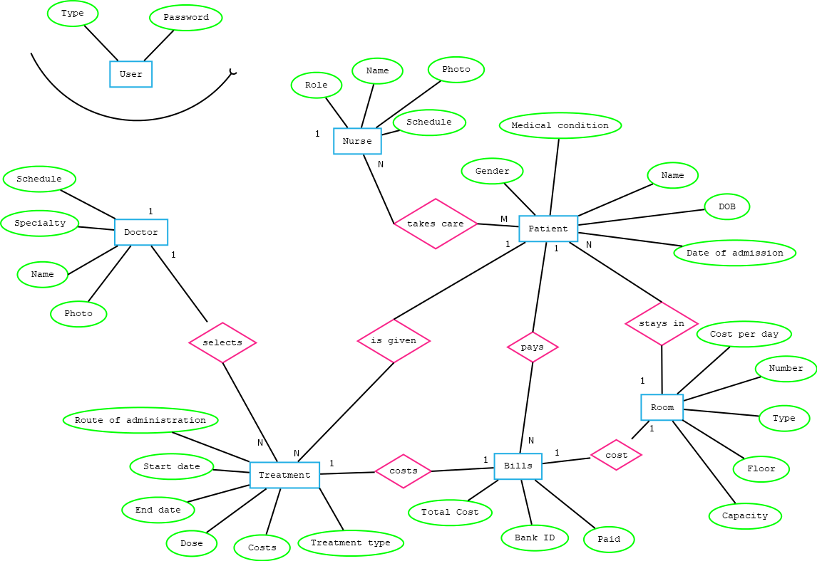

Slide 4
DOCTOR
ID | NAME | SPECIALTY | SCHEDULE | PHOTO
1 | Pepe | Oncology | Morning
PATIENT
ID | NAME | GENDER | DOB | DATE OF ADMISSION | DIAGNOSE | ROOM ID
2 | Lola | Female | 7/1/1999 | 12 /2/2018 | Liver Cancer | 3
TREATMENT
ID | TREATMENT TYPE | COST | DOSE | WAY OF ADMINISTRATION | START DATE | END DATE | PATIENT ID | DOCTOR ID | BILL ID
5 | Chemotherapy | 30$ |  | Intravenous | 13/2/2018 | 18/2/2018 | 2 | 1 | 8
ROOM
ID | FLOOR | NUMBER | TYPE | CAPACITY | COST PER DAY | BILL ID
3 | 7 | 101 | Suite room | 1 | 15$ | 9
BILLS
ID | TOTAL COST | BANK ID | PAID | PATIENT ID
8 | 30$ | 65894 | yes | 2
9 | 75$ | 65894 | yes | 2
NURSE
ID | NAME | ROLE | SCHEDULE | PHOTO
7 | Alejandra | Bring lunch | Morning
NURSE ID | PATIENT ID
7 ----------------- | 2 ------------------------- | ----------------- | --------------- | ------------------------------------- | --------------------------- | ----------------- | ----------------- | ----------------- | -----------------
USER
ID | PASSWORD | TYPE
1 | ap2 | Doctor
2 | 54 | Nurse

Slide 5
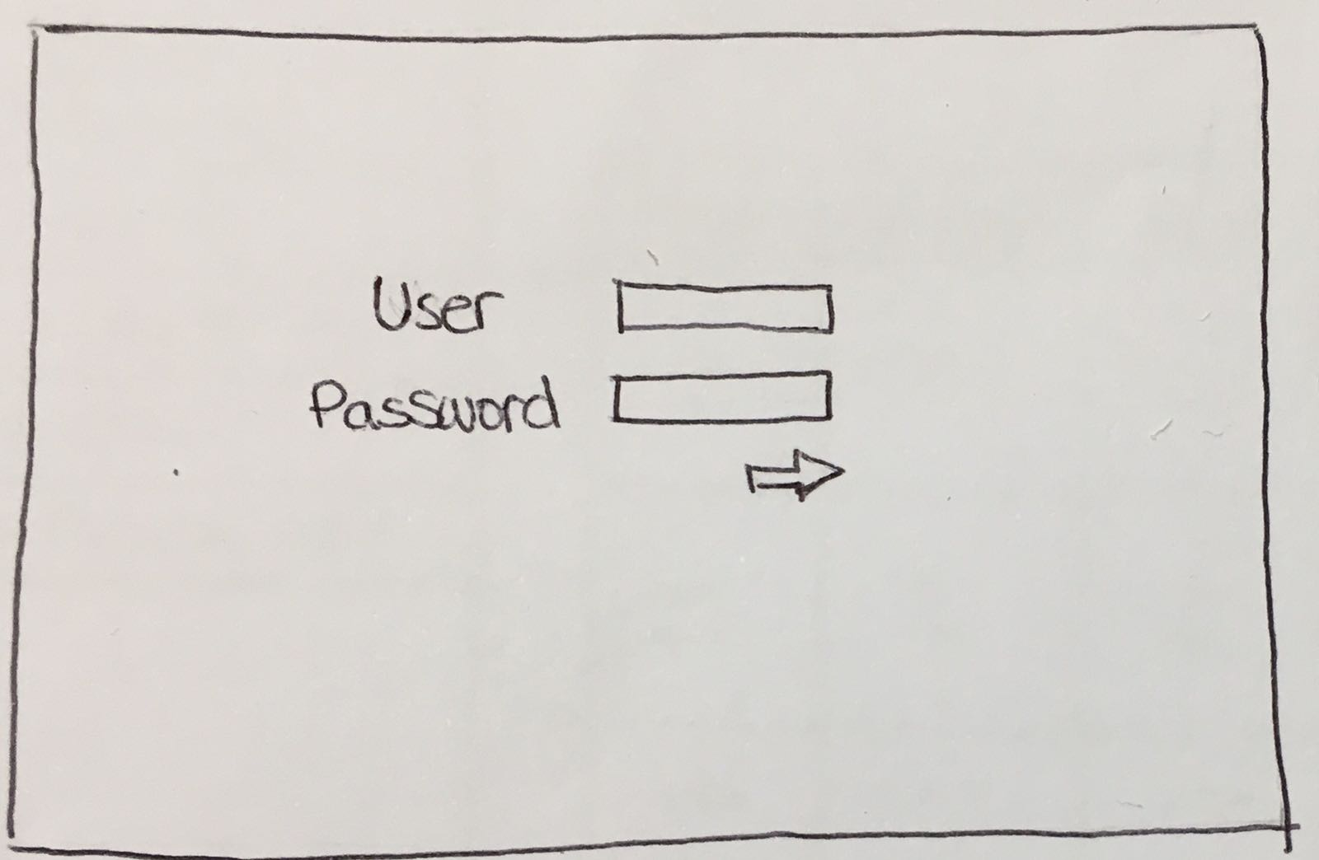
View doctors
View nurses
Admin
User magagement
Add patients
Discharge patients
Receptionist
Billing reports
View patient details
Doctor
Add treatment
View patient details
Nurse

Slide 6
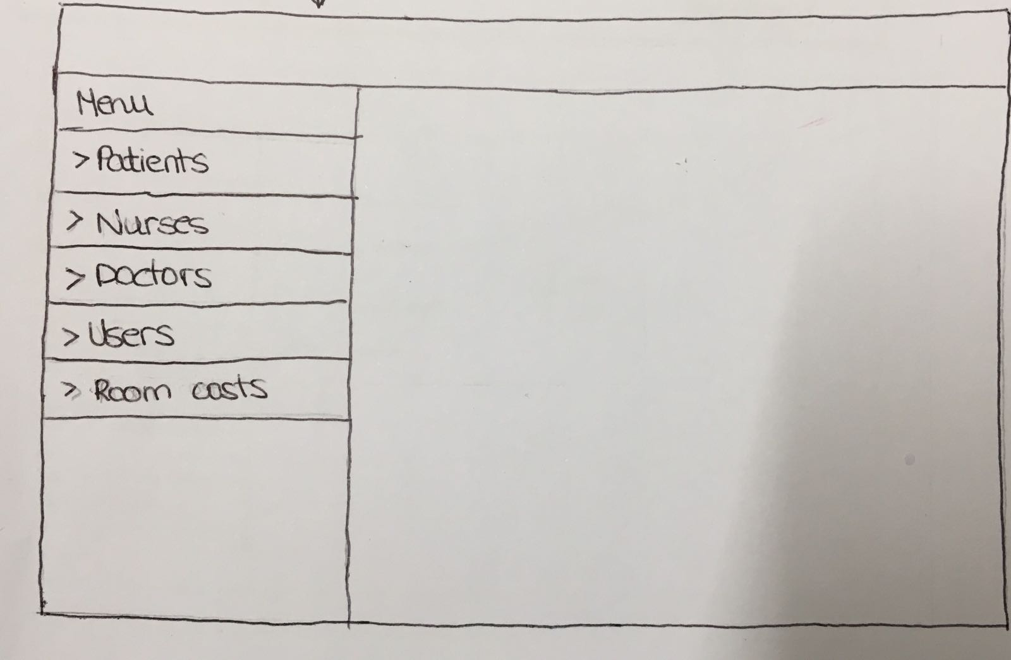
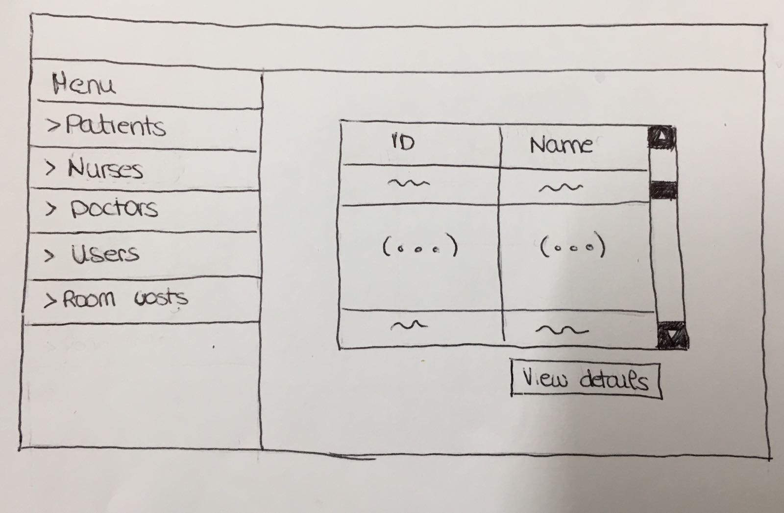
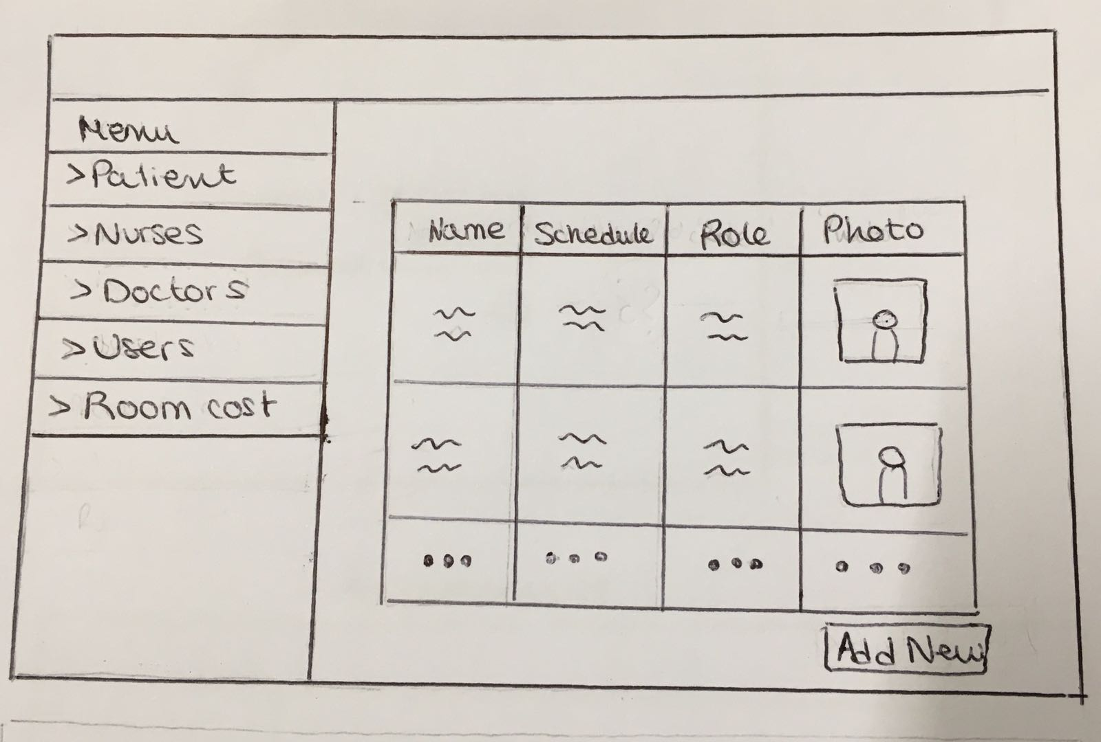

Slide 7
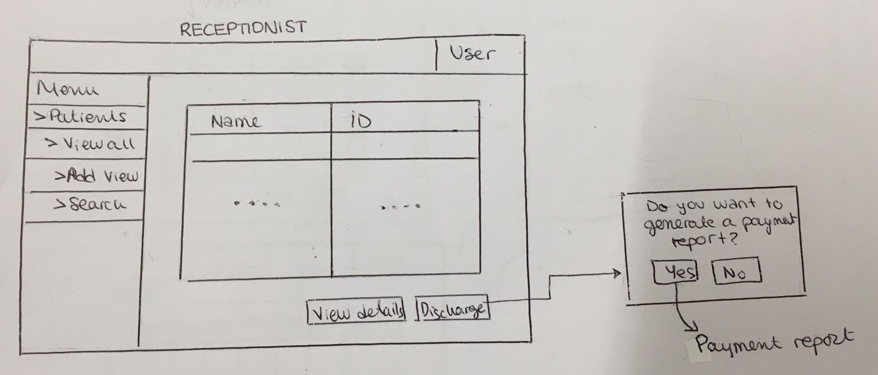

Slide 8
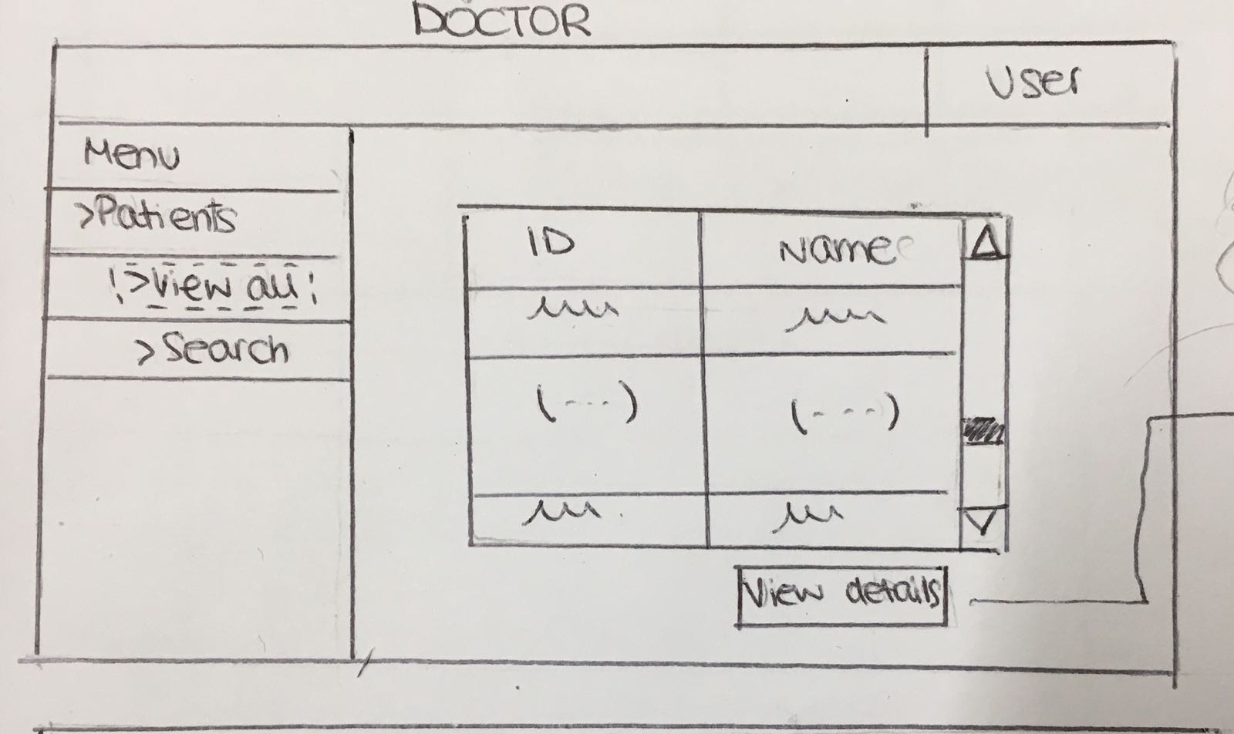
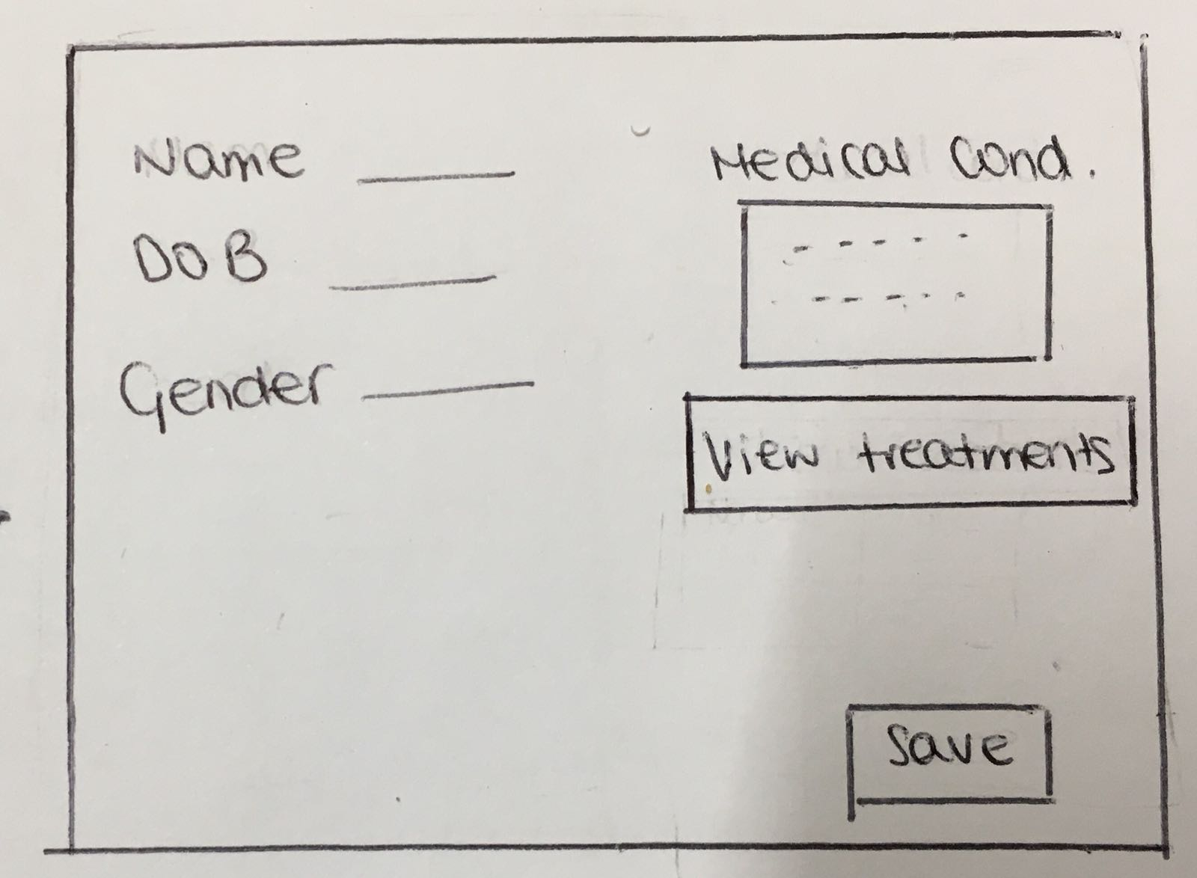
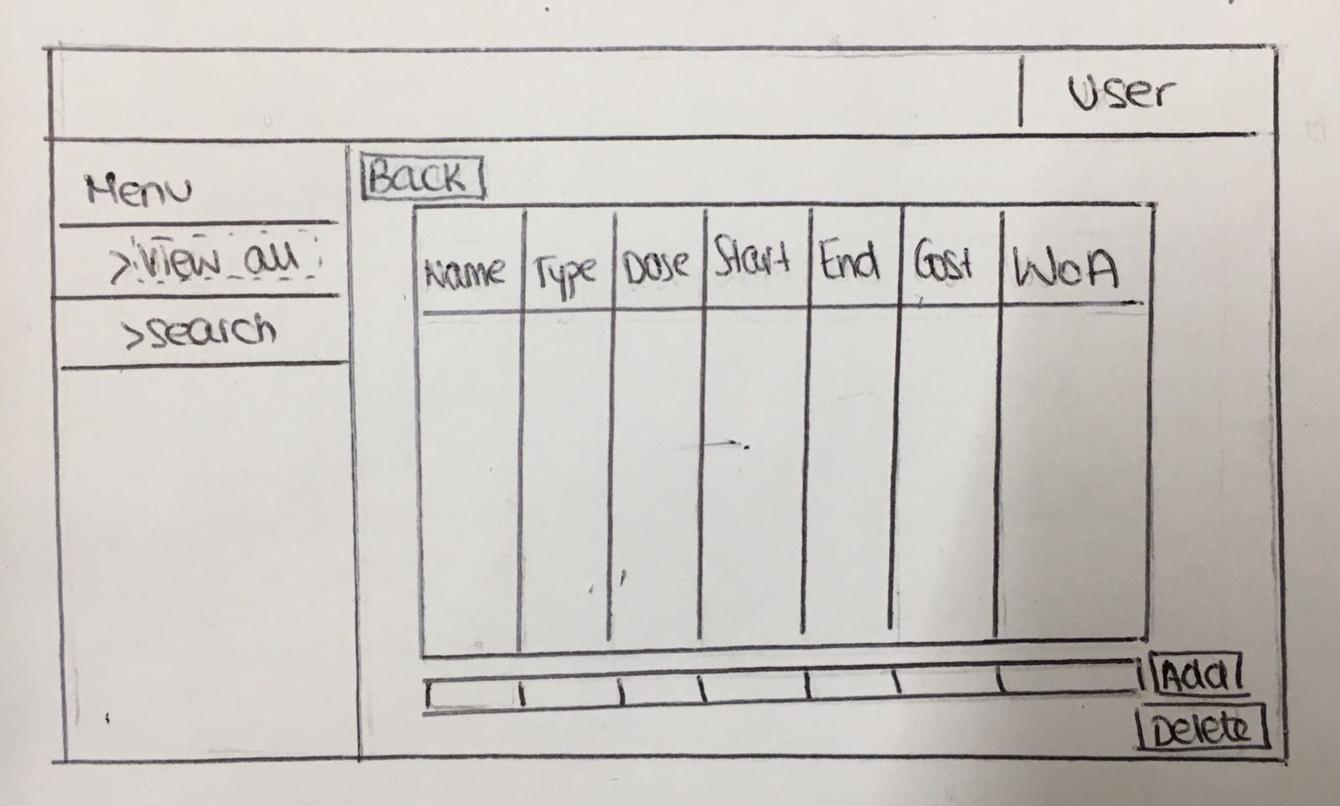

Slide 9
THANK YOU

